Slide 1
Hybrid Quantum-Classical Neural Networks
for Stock Price Forecasting
A Comparative Study of Classical and Quantum-Enhanced Models for Stock Price Prediction
Nathaniel James Pacey
For Terra Quantum

Slide 2
Table of contents
01
03
02
04
Problem Definition
Optimization
Motivation for the selection of data and methodology
Optimizing hyperparameters and architecture choices
final model description
Methodology
Results & Discussion
Data source and preprocessing, model architecture
Training & Validation
Results comparisons

Slide 3

01
Introduction
Financial time series forecasting is complex due to volatility, noise, and external factors.
Traditional machine learning models often struggle to generalize across market conditions.

Slide 4
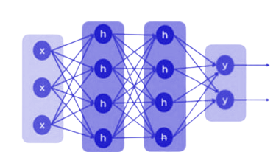
Problem Definition
To predict stock values accurately, this project leverages classical Machine Learning (ML) and Hybrid Quantum ML.
Specifically a modular hybrid model combining recurrent neural networks (RNNs) with a variational quantum layer.
Goal to investigate whether quantum-classical hybrid architectures can improve stock price prediction accuracy.

Slide 5
02
Methodology
Initial Model Design Including Data Source & Preprocessing

Slide 6


Data Source and Preprocessing
Data:
Daily closing prices for AAPL, MSFT, and GOOGL (2015–2024) via yfinance API.
Data Cleaning:
Forward-filled missing values to maintain continuity.
Min-Max normalization applied per ticker to [0, 1] range.
Data Structuring:
Sliding window of 20 time steps mapped to the next price.
Preserved short-term dependencies and momentum patterns.
Train/Test Split:
80/20 split without time leakage to maintain chronological order.
Dataset Composition:
Combined sequences across tickers to improve model diversity and generalization.
Notes:
Modular like Terra’s QAI Hub.
After processing all tickers individually, the resulting training and testing sequences were concatenated across tickers to form a single, aggregated dataset.

Slide 7
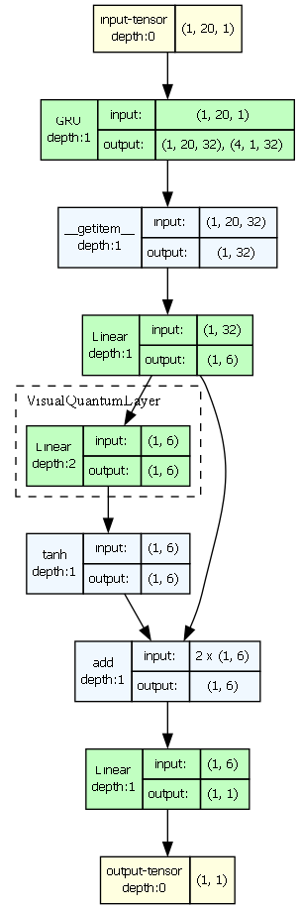
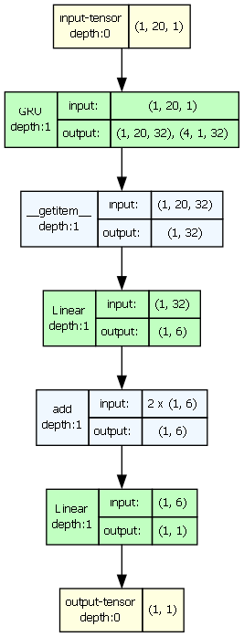
Modular Model Architecture
Quantum Hybrid Model
Classical Model
Input Tensor: (batch size, 20, 1) — 20 time steps, 1 feature.
Recurrent Units: (LSTM, GRU, RNN — single or mixed)
Hidden State Extraction
Linear Layer (Classical Projection):
Optional Quantum Layer: Process n features through a variational quantum circuit.
Post-Quantum Activation: (e.g., Tanh, Sigmoid, ReLU).
Skip Connection (Add or Concat): Merge classical and quantum feature vectors.
Final Linear Layer: Compress merged 6 features → 1 scalar output.
Final Activation: (e.g., Tanh, Sigmoid, ReLU)
Output Tensor: Shape (batch size, 1) — Predicted stock price.
Notes:
Modular like Terra’s QAI Hub. Flexible iterable structure
Pytorch
Model Forward Pass Overview: In short: Overall design influenced by Qiskit and PennyLane Tutorials but also important papers
Input Tensor:
Shape: (batch size, 20, 1) — 20 time steps, 1 feature.
(User can configure sequence length if needed.)
Recurrent Units (User-Defined Configuration):
Choice of LSTM, GRU, RNN, or mixed combinations.
User defines the sequence and number of layers in the first block; subsequent blocks default to one layer.
Output: Hidden states (batch size, 20, 32) and final hidden state (batch size, 4, 1, 32).
Hidden State Extraction:
Final hidden state is reshaped to (batch size, 32).
Linear Layer (Classical Projection):
Projects 32 features → user-defined number of features (e.g., 6) for input to the quantum layer.
(User can configure projection dimension based on number of qubits.)
Optional Quantum Layer (User-Enabled):
If enabled, projected features are passed through a variational quantum circuit (PennyLane QNode).
User can configure quantum depth (number of variational layers) and number of qubits.
Data encoding via RY gates.
Post-Quantum Activation and Regularization (Optional):
User can select an activation function (e.g., Tanh, Sigmoid, ReLU) after the quantum layer.
Optional regularization steps: dropout, layer normalization.
Skip Connection (User-Defined Type):
Merge classical and quantum features by addition or concatenation.
(User can choose the skip connection method.)
Final Linear Layer:
Compress merged 6 features → 1 scalar output.
(User can apply an optional output activation function, e.g., Tanh for bounded output.)
Output Tensor:
Shape: (batch size, 1) — Predicted stock price.
Influenced by these papers:
20 time steps → A typical window size for capturing short-term dependencies in time series forecasting Qin et al., "A Dual-Stage Attention-Based Recurrent Neural Network for Time Series Prediction," 2017
1 feature → Matches a univariate forecasting setup, standard in financial time series prediction Nelson et al., "Stock market prediction using LSTM," 2017}.
Hidden state flattening → Standard practice for connecting recurrent layers to dense layers Hochreiter & Schmidhuber, "Long Short-Term Memory," 1997.
Linear projection → Reduces dimensionality to match the quantum circuit input size, as common in hybrid quantum-classical models Schuld et al., "Circuit-centric quantum classifiers," 2020.
Skip connection → Used to preserve classical features and improve robustness when integrating quantum circuits Pérez-Salinas et al., "Data re-uploading for a universal quantum classifier," 2020.
Output as 1 scalar → Standard for regression tasks like stock price forecasting Fischer & Krauss, "Deep learning with long short-term memory networks for financial market predictions," 2018.

Slide 8
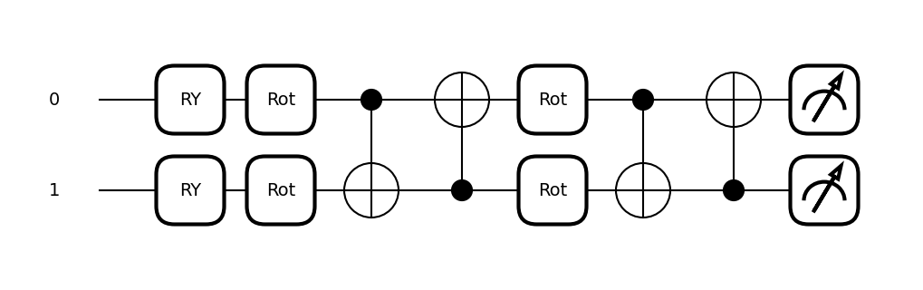
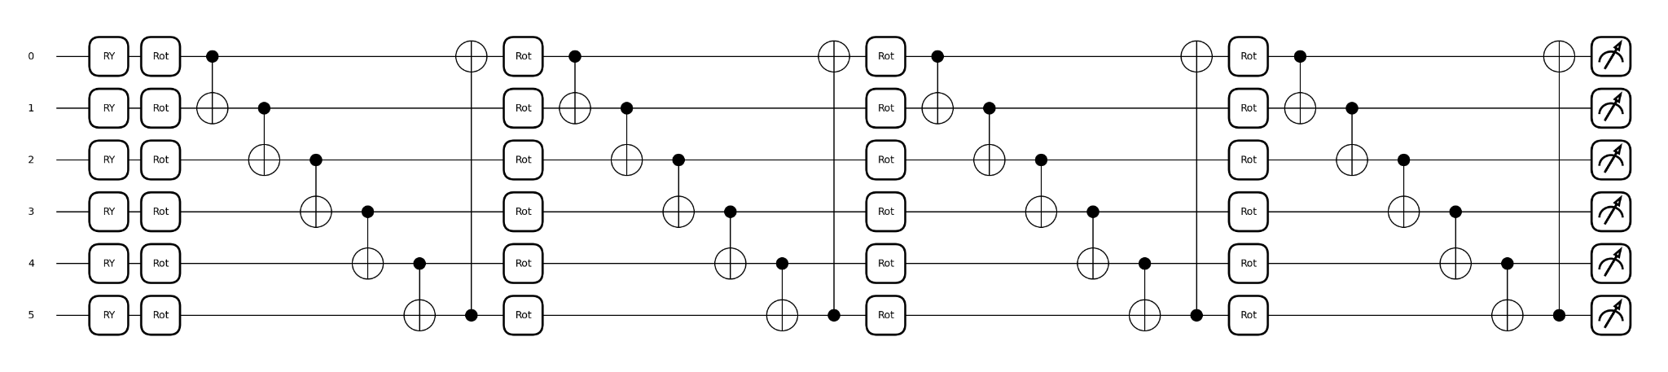
Quantum Layer - Variational Quantum Circuit
Simple Variational Quantum Circuit:
2 qubits, 2 layers (Q-depth = 2)
Final Variational Quantum Circuit:
6 qubits, 4 layers (Q-depth = 4)
Notes:
If the quantum layer is enabled, the projected features are passed through a variational quantum circuit (built using PennyLane’s QNode interface, as shown in Figure 1 [8]), where each feature is encoded via an RY gate [9]. Across a configurable number of variational layers (q depth), each qubit undergoes a parameterized rotation: After each layer, qubits are entangled via a ring of CNOT gates to create a circular topology [10]. The output is obtained by measuring the expectation value of PauliZ on each qubit, producing a real-valued vector.
Why This Variational Quantum Circuit Design Was Used:
The variational quantum circuit follows a widely adopted structure for hybrid models, particularly in PennyLane tutorials and quantum machine learning literature~\cite{schuld2020circuitcentric, benedetti2019parametrized}.

Slide 9
03
Optimization
Training Strategy, Hyper Parameter and Architecture Optimization

Slide 10
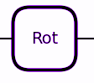
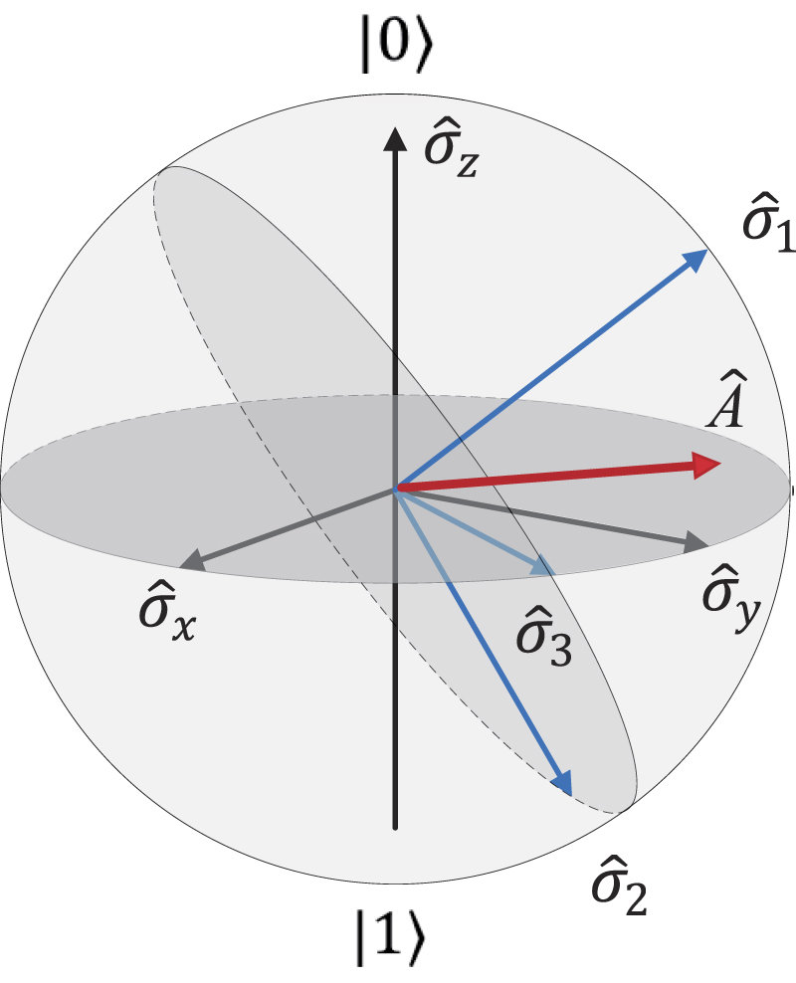
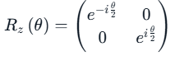
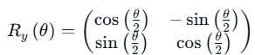
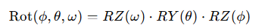
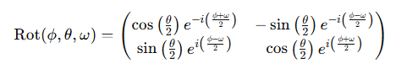
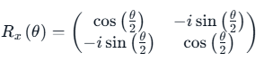
Quantum Circuit Optimization
Parameterized Rotation
=
3 Parameters:
1 Parameter:
2 Parameters:
Notes:
either RY (1 parameter), RX + RZ (2 parameters), or Rot (3 parameters).
Quantum Circuit Optimization — Rotational Gates:
1-Parameter Rotation (RY Gate):
Rotation around the Y-axis only.
Simple rotation; one degree of freedom (θ).
Limited expressivity — can only move the qubit along the YZ plane on the Bloch sphere.
2-Parameter Rotations (RX and RZ Gates):
RX(θ): Rotation around the X-axis.
RZ(θ): Rotation around the Z-axis.
Adding RX and RZ gates gives access to more directions, allowing qubit states to spread more freely across the sphere, but still not full arbitrary control.
3-Parameter Rotation (General Rot Gate):
Combination of RZ(ω) → RY(θ) → RZ(ϕ) rotations.
Three degrees of freedom (ϕ, θ, ω).
Allows full coverage of the Bloch sphere — any pure qubit state can be reached.
This general rotation is universal for single-qubit transformations.

Slide 11
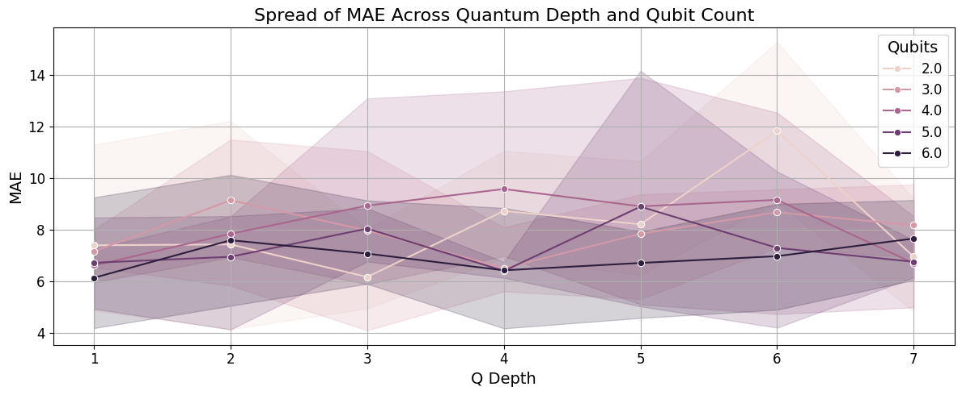
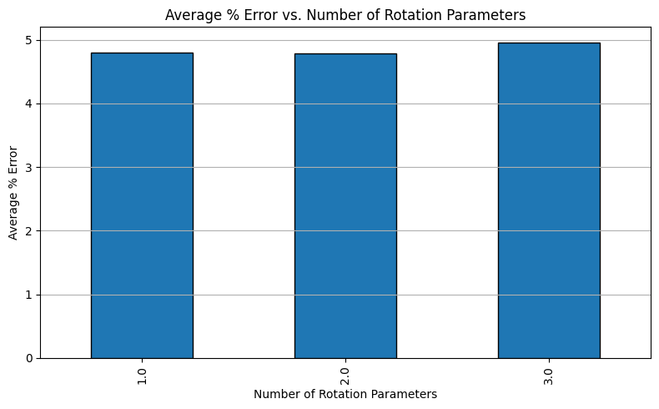
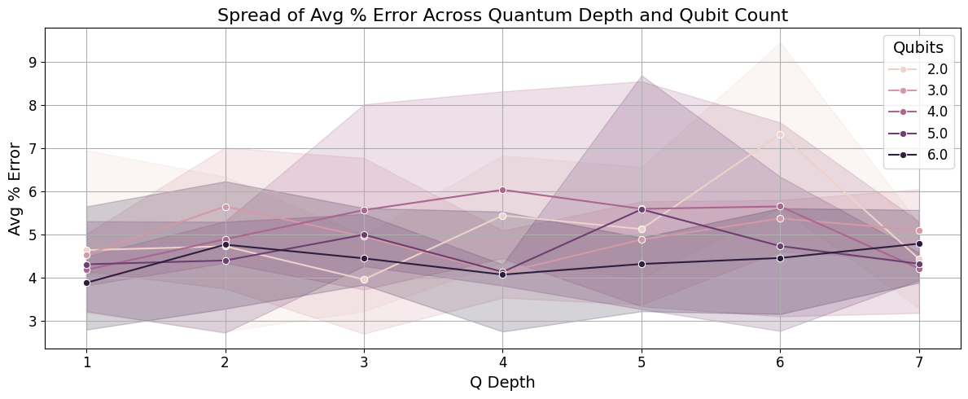
Quantum Circuit Optimization
Quantum Circuit Grid Search
Tested over 10 epochs
Number of Qubits (2–6), circuit depth (1–7), and gate complexity (1–3 parameters)

Slide 12
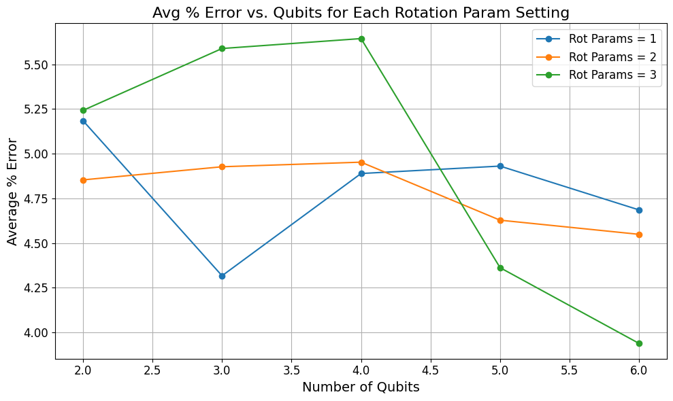
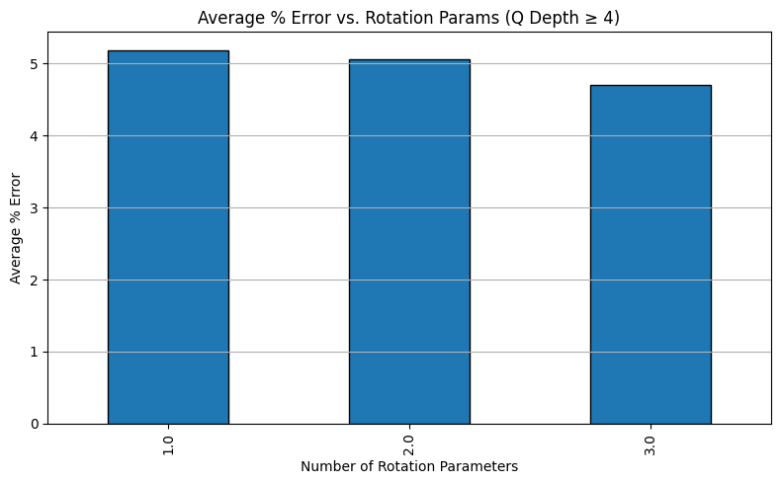
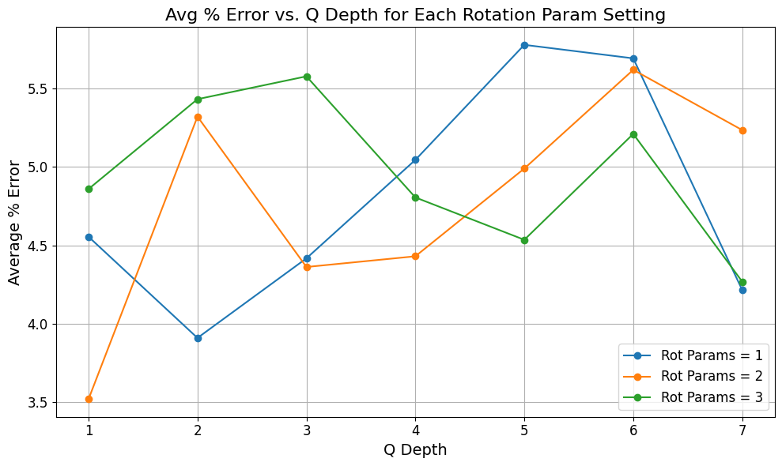
Quantum Circuit Optimization
Threshold
Quantum Circuit Grid Search
Focus on where a Full Rotation outperforms

Slide 13
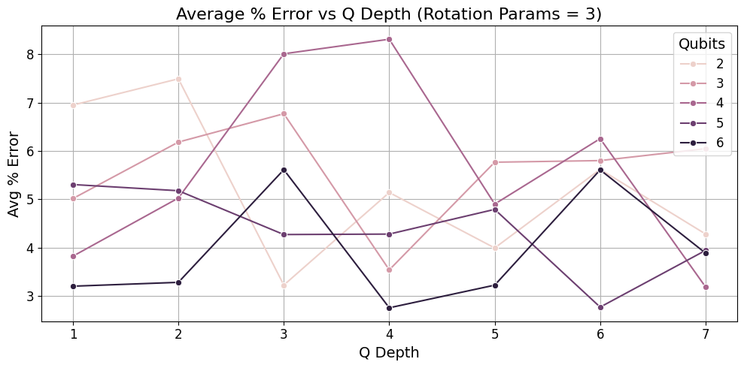
Quantum Circuit Optimization
Final Selection
Final Variational Quantum Circuit:
6 qubits, 4 layers (Q-depth = 4), Full Rotation Gate

Slide 14

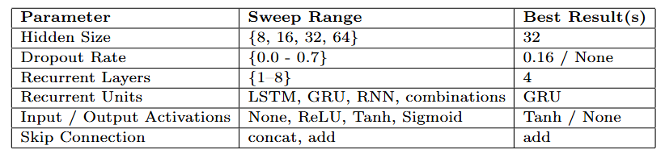
Classical Architecture Optimization
Classical components optimized separately to reduce quantum training time over 10 epochs.
Parameter sweeps with modular Python scripts; one parameter varied at a time. Results saved in Excel.
Coarse-grained sweeps followed by fine-grained searches for refinement.
Best configurations selected based on MAE, RMSE, and average percentage error.
Final Configuration: GRU units, 4 layers, hidden size = 32, add skip connection, Tanh post-quantum activation, no dropout.

Slide 15
04
Results
Evaluation of Hybrid Model and Comparison to Classical Model

Slide 16
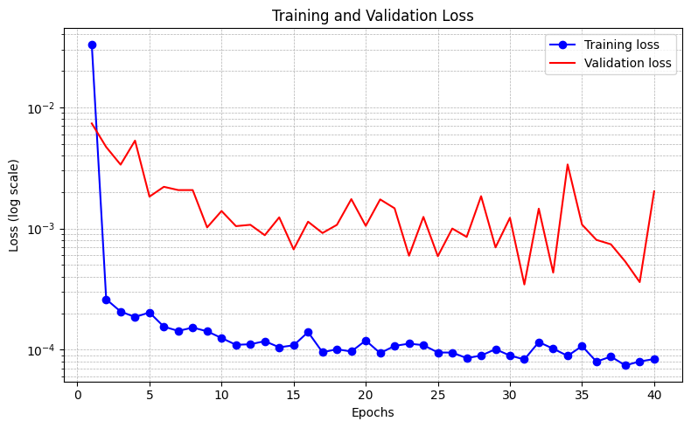
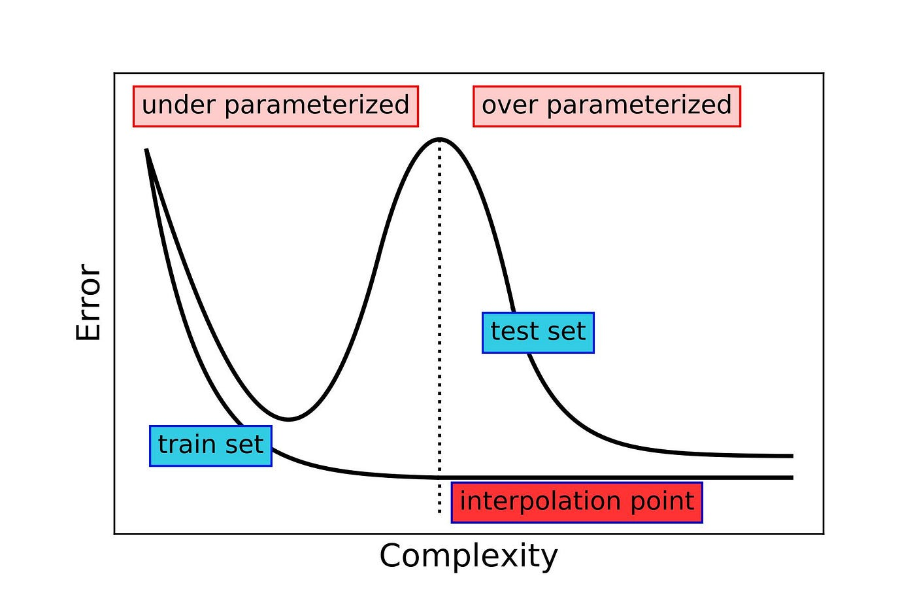
Training & Validation
Hybrid models trained for 40 epochs, achieving a best training loss of 0.000083 and validation loss of 0.000346.
Overfitting and Model Complexity:
Higher validation loss suggests overfitting or possible double descent behavior; further tuning of model depth, quantum circuit size, and training duration is required.

Slide 17
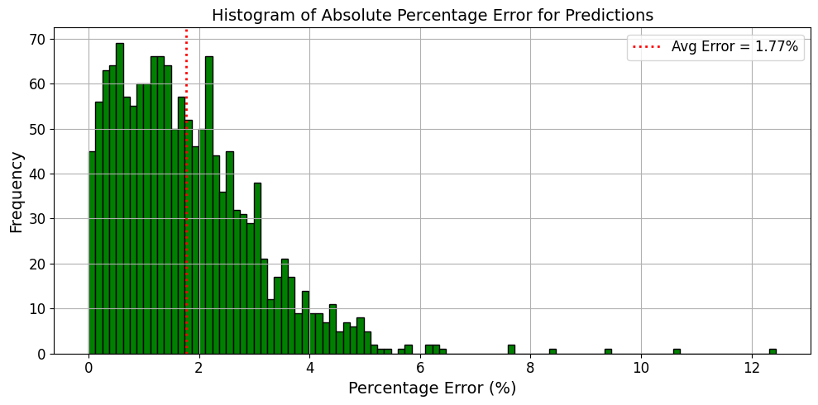
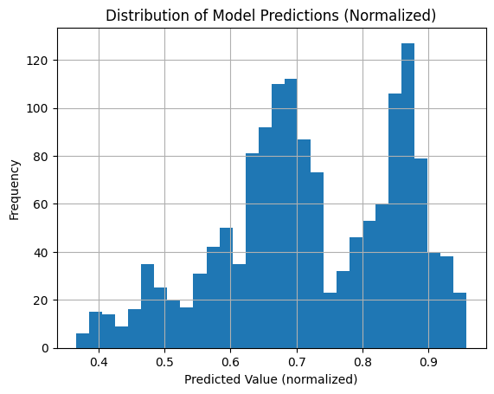
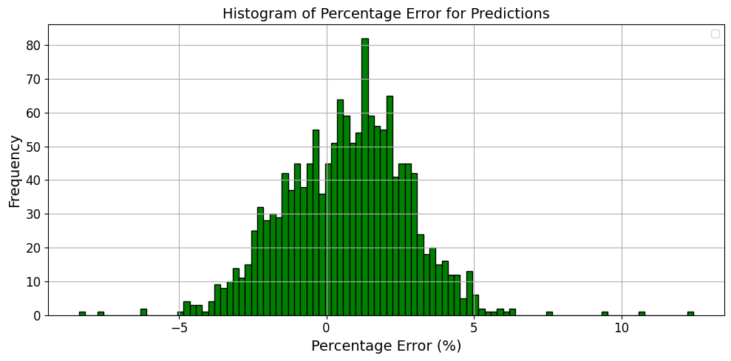
Hybrid Model Predictions
Predictions Distribution: Ranges over full 0 to 1 with two distinct peaks
Model Evaluation Metrics: Test MAE = 2.5660, Test RMSE = 3.1719, and Average Absolute Percentage Error = 1.77%.
Error Distribution Analysis: Most prediction errors fall within 0–2%, centered near 0%, indicating high accuracy and minimal bias.

Slide 18
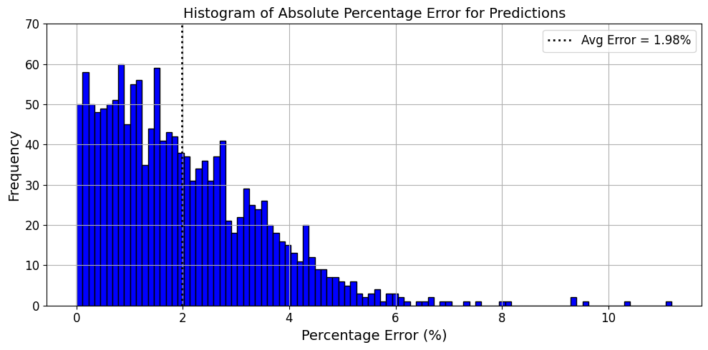
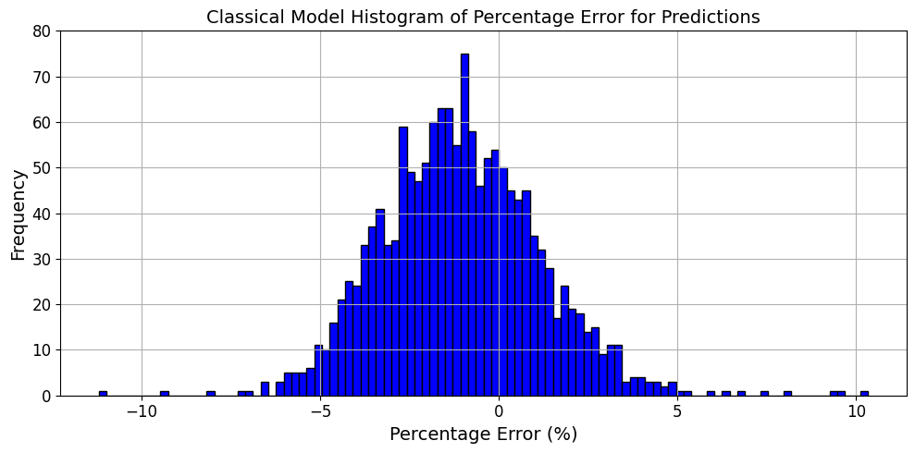
Predictions
Comparison
Classical Model
Hybrid Quantum Model
Metric | Hybrid Model | Classical Model
Test MAE | 2.566 | 3.0522
Test RMSE | 3.1719 | 3.9727
Average Absolute Percentage Error | 1.77% | 1.98%
Notes:
Not a clear advantage - due to probabilistic variances this difference can fall into the range of expected outcomes Therefore more work needs to be done to confirm and try and come up with clear differences Maybe on smaller epochs quantum outperforms

Slide 19
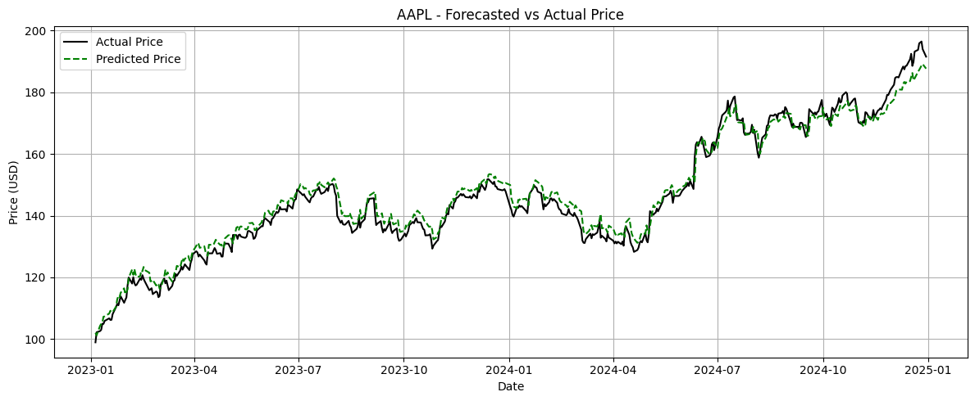
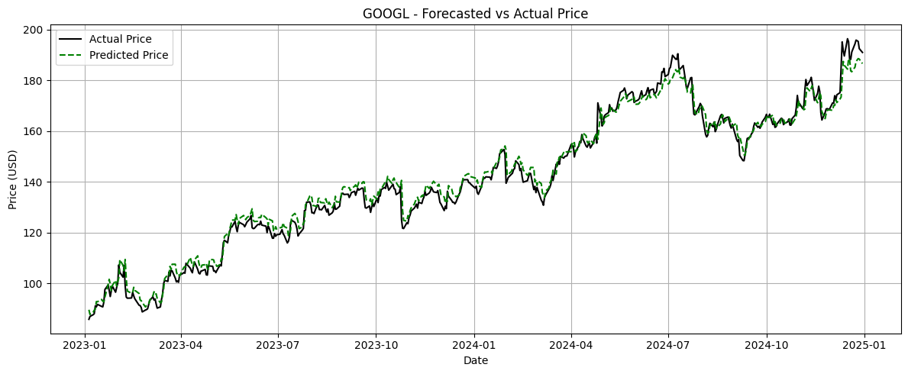
Hybrid Model Price Predictions

Slide 20
Conclusions & Future Work
Metric | Hybrid Model | Classical Model
Test MAE | 2.566 | 3.0522
Test RMSE | 3.1719 | 3.9727
Average Absolute Percentage Error | 1.77% | 1.98%
Conclusion
Hybrid model showed slight improvement over classical, but within typical uncertainty ranges.
No definitive advantage of the quantum layer yet; further validation needed across more datasets.
Future Work
Accelerate training using parallelization, GPU support, or cloud quantum platforms.
Optimize additional hyperparameters (e.g., learning rate) and explore alternative quantum circuit designs.
Expand dataset to include more stock tickers and additional features.
Test hybrid models on real quantum hardware and different quantum platforms (e.g., Qiskit).
Evaluate model performance on live or unseen financial data or new stock To see overparameterized or under-parameterized.

Slide 21
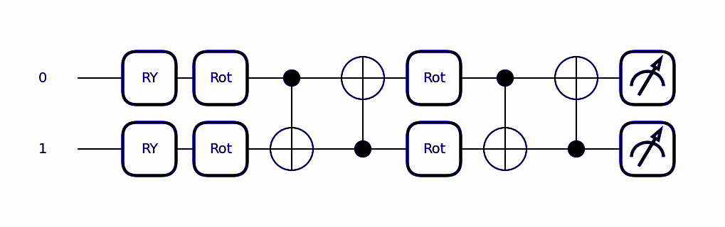
Thank you!
Do you have any questions?

